Slide 1

JANSONS INSTITUTE OF TECHNOLOGY
DEPARTMENT OF COMPUTER SCIENCE ENGINEERING
PREDICTIVE ANALYTICS IN LUNG DISEASE HARNESSING AI FOR DETECTION AND PREVENTION
FINAL REVIEW
BATCH-20
PREPARED BY :
P.SAIRAM (711120104052)
P.VIVEK (711120104053)
P.MADHUSUDHAN REDDY (711120104055)
SRI SIVA RANGA SAI .G (711120104076)
GUIDED BY :
V . PRASATHKUMAR
Assistant Professor , CSE

Slide 2
ABSTRACT
Alarming increasing rate of air pollution levels and drop in the air quality due to various factors like increased demands in private transportation, need for more buildings, booming population growth and the globalization, the respiratory problems have dramatically increased. The growing interest in a non-invasive and objective way for monitoring these diseases paved way for this project. The developed system includes a hardware module to monitor several parameters like heartbeat rate, SpO2 (Saturation of Peripheral Oxygen), exhaled air temperature and humidity, nitrogen, and acetone level in the breath. The objective is to create a user-friendly device that can gather human data using a flow sensor, temperature sensor, gas sensor, and SpO2 sensor.

Slide 3
INRTODUCTION
From the information gathered from the World Health Organization (WHO) report, 262 million people are diagnosed with asthma, a common disease among children. 90% of those COPD deaths of people under 70 years of age occur in low- and middle-income countries. Lung diseases are prevalent medical conditions around the world, with examples including asthma, chronic obstructive pulmonary disease (COPD), pneumonia, and lung cancer. These conditions have a considerable impact on an individual's overall health and can restrict their ability to perform daily activities, potentially leading to disability or death. By conducting research on lung diseases, we can gain a deeper understanding of their causes, risk factors, and effective treatments, which can enhance people's health outcomes through improved diagnosis, management, and prevention strategies.

Slide 4
PROBLEM STATEMENT:
“Inefficient early detection methods and limited preventive measures contribute to high mortality rates in lung diseases. Leveraging predictive analytics and AI, there is a critical need to develop proactive strategies for early detection and prevention, aiming to improve patient outcomes and reduce healthcare burdens."

Slide 5
Existing System:
In the existing system, the focus is often on diagnosing lung diseases after symptoms have manifested or when they've progressed significantly. Traditional diagnostic methods include medical imaging (like X-rays and CT scans) and pulmonary function tests. However, these methods may not always detect lung diseases in their early stages, leading to delayed treatment and poorer outcomes for patients. Additionally, these methods rely heavily on the expertise of healthcare professionals, and there can be variations in interpretation and diagnosis.
Moreover, patient data management in the existing system may not fully leverage the potential of predictive analytics and AI. Electronic health records (EHRs) contain valuable information, but analyzing them comprehensively and in real-time for predictive purposes can be challenging without advanced computational tools.

Slide 6
DISADVANTAGES:
Data Quality and Availability: Predictive analytics heavily relies on data quality and availability. In the case of lung diseases, obtaining high-quality and comprehensive datasets can be challenging due to privacy concerns, data silos, and inconsistencies in data collection methods.
Bias in Data: Existing datasets may suffer from bias, which can lead to inaccurate predictions, especially for underrepresented populations. This bias can arise from various sources, including demographics, geographical location, and access to healthcare.

Slide 7
PROPOSED SYSTEM
Data Acquisition and Integration:
Collaborate with healthcare institutions, research organizations, and public health agencies to gather diverse datasets encompassing patient demographics, clinical records, environmental factors, genetic information, and lifestyle behaviors.
Utilize data integration techniques to harmonize and consolidate heterogeneous data sources into a unified dataset suitable for predictive modeling.
Data Preprocessing and Feature Engineering:
Conduct comprehensive data preprocessing to address missing values, outliers, and noise in the dataset.
Engage domain experts to identify relevant features and create new variables through feature engineering techniques.
Explore dimensionality reduction methods to extract informative features and reduce computational complexity.

Slide 8
SIGNIFICANCE OF THE PROPOSED SYSTEM:
Continuous Monitoring and Improvement:
Establish mechanisms for ongoing monitoring of model performance and user feedback in clinical settings.
Conduct regular updates and recalibration of the predictive models using new data and emerging research findings.
Foster a culture of continuous learning and quality improvement through multidisciplinary collaborations and knowledge sharing among stakeholders.
Ethical Considerations and Patient Engagement:
Adhere to ethical principles of beneficence, non-maleficence, autonomy, and justice in the design, implementation, and evaluation of the predictive analytics system.
Ensure transparent communication with patients regarding the purpose, risks, and benefits of using AI-based predictive models for lung disease prevention.
Empower patients to actively participate in their healthcare decisions through education, shared decision-making, and access to personalized risk assessments and preventive recommendations.

Slide 9
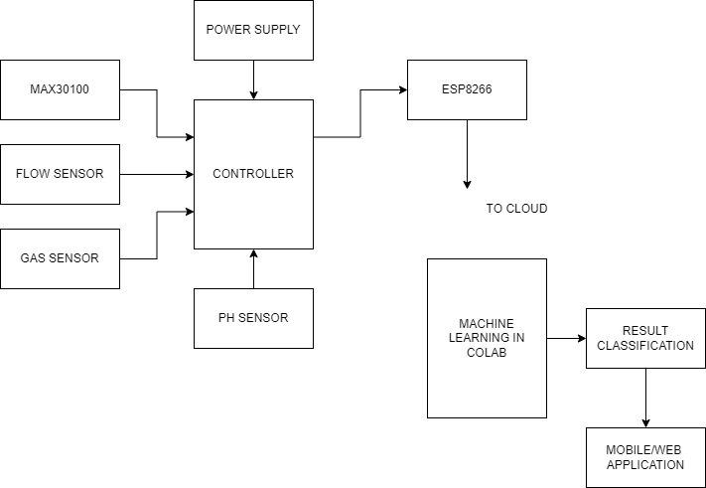
BLOCK DIAGRAM

Slide 10
MODULE DESCRIPTION
Data Acquisition Module:
Responsible for acquiring data from various sources, such as electronic health records (EHRs), medical devices, wearable sensors, environmental monitors, and genetic databases.
Includes connectors, adapters, or APIs to fetch data in real-time or batch mode from heterogeneous data sources.
Ensures data integrity, security, and compliance with privacy regulations during data acquisition processes.
Data Preprocessing Module:
Performs data cleaning, transformation, and normalization to prepare raw data for analysis.
Handles missing values, outliers, and inconsistencies through imputation, filtering, or error correction techniques.
Conducts data validation checks to ensure data quality and reliability before further processing.

Slide 11
SYSTEM ARCHITECTURE
Feature Engineering and Model Training Layer:
Extract relevant features from the preprocessed data using feature engineering techniques, dimensionality reduction algorithms, or natural language processing (NLP) methods.
Develop and train machine learning models, deep learning architectures, or probabilistic graphical models to predict the risk of lung diseases based on the extracted features.
Leverage distributed computing resources, GPU accelerators, or cloud-based machine learning platforms for scalable model training and hyperparameter optimization.
Model Deployment and Inference Layer:
Deploy trained models to production environments using containerization technologies, such as Docker or Kubernetes, for scalability, portability, and reproducibility.
Expose model APIs or web services for real-time or batch inference, enabling seamless integration with clinical applications, decision support tools, or patient-facing interfaces.
Implement load balancing, auto-scaling, and fault tolerance mechanisms to ensure high availability and performance of the inference services.

Slide 12
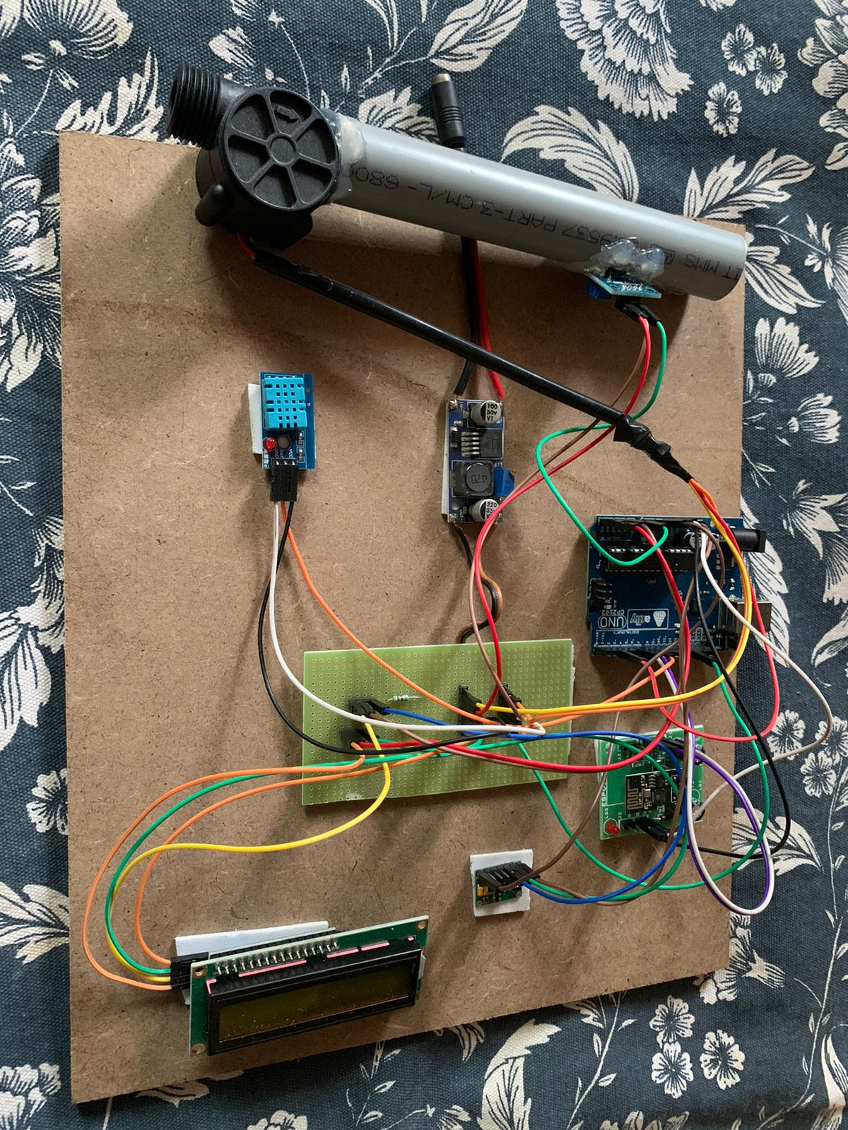
WORKING MODULE FOR PROJECT

Slide 13
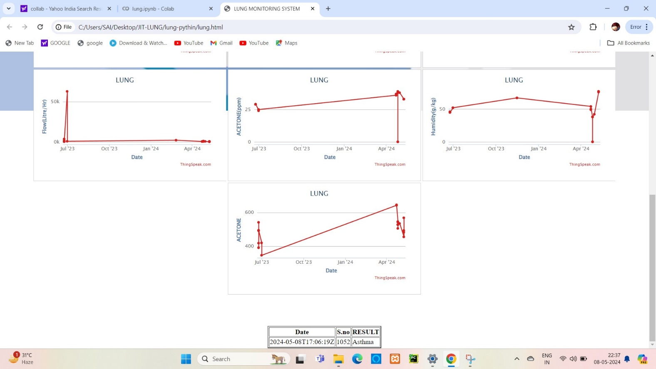
TESTING AND VALIDATION

Slide 14
CONCLUSION
With the newly created equipment, lung examinations may be done quickly and efficiently. The mentioned system is simple to use, inexpensive, and provides instant access to data. The developed system achieves the on-time monitoring through a monitoring device. The module developed monitors the basic respiratory and environmental factors. Along with it there is a small unit to monitor the physical activity.

Slide 15
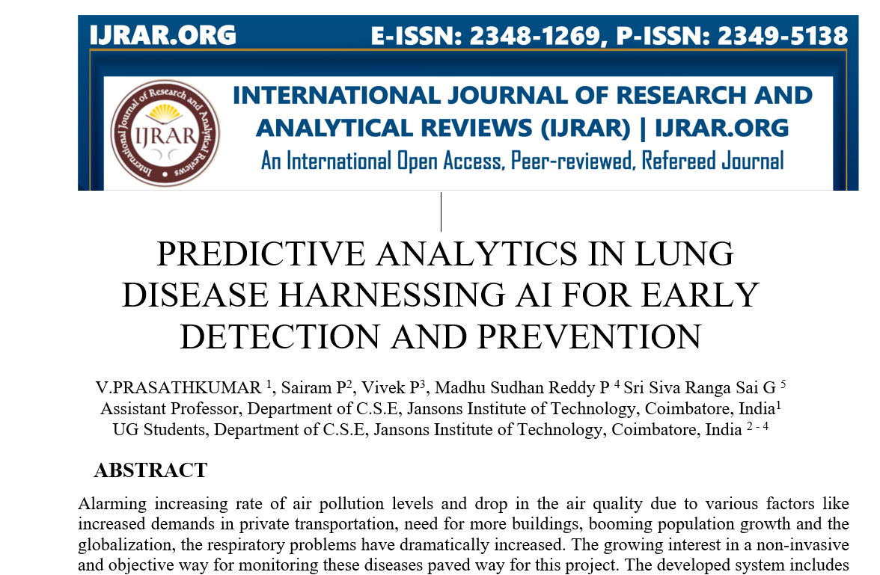
We published our project “Predicitve Analytics in Lung Disease Harnessing AI for Early Detection and Prevention” in “International Journal of Contemporary Engineering Sciences and Emerging Technologies”.

Slide 16
REFERENCES
Y Tham, M.A. Markom, A.H. Abu Bakar , E.S. Mohd Muslim Tan, A.M. Markom, “loT Health Monitoring Device of Oxygen Saturation (SpO2) and Heart Rate Level”, IEEE- 2020.
Markus Hoglinger ,Bianca Wiesmayr ,Werner Baumgartner & Anna Theresia S Stadler , “A Rapid and Low-Cost Lung Function Testing Method Based on an Optical Flow Sensor” Springer, 2020.
S. Arun Kumar; B. Gopinath, A. Kavinraj, “Towards Improving Patient Health Monitoring System using Machine Learning and Internet of Things”, IEEE, October 2021.
Kavyashree; K Lavanya; K Nikitha; Sowmya; S R Deepthi, “Low-Cost Wearable Asthma Monitoring System with a Smart Inhaler”, IEEE, August 2021.
V.G. Sivakumar, S.P. Vimal, M.Vadivel , V.Vijaya Baskar, “Novel Approach to Monitor the Respiratory Rate for Asthma Patients”, Springer,2022.

Slide 17
CODE IMPLEMENTATION:
import numpy as np
import pandas as pd
from sklearn import metrics
from sklearn.model_selection import train_test_split
import matplotlib.pyplot as plt
import seaborn as sns
import pickle
data = pd.read_csv('data.csv')
data.head()
data.shape

Slide 18
X = data.iloc[:,:-1]
X.head()
y = data.iloc[:,-1]
y.head()
data['Diagnosis'].value_counts()
X_train,X_test,y_train,y_test = train_test_split(X,y,test_size=0.5,random_state=2)
sns.countplot(x='Diagnosis',data=data)
plt.show()
X_train.shape
X_train.head()
y_test.shape
y_test.head()

Slide 19
from sklearn.metrics import accuracy_score
max_accuracy = 0
from sklearn.neighbors import KNeighborsClassifier
for x in range(1,143):
model = KNeighborsClassifier(n_neighbors=x)
model.fit(X_train,y_train)
y_pred = model.predict(X_test)
current_accuracy = round(accuracy_score(y_pred,y_test)*100,2)
if(current_accuracy>max_accuracy):
max_accuracy = current_accuracy
best_x = x

Slide 20
#print(max_accuracy)
#print(best_x)
model = KNeighborsClassifier(n_neighbors=best_x)
model.fit(X_train,y_train)
y_pred = model.predict(X_test)
filename = 'knn.sav'
pickle.dump(model, open(filename, 'wb'))
acc=(metrics.accuracy_score(y_pred,y_test)*100)
print("Accuracy is:",acc)

Slide 21
THANK YOU

